Slide 1



NAKSHATRAM ASHWINI

Slide 2

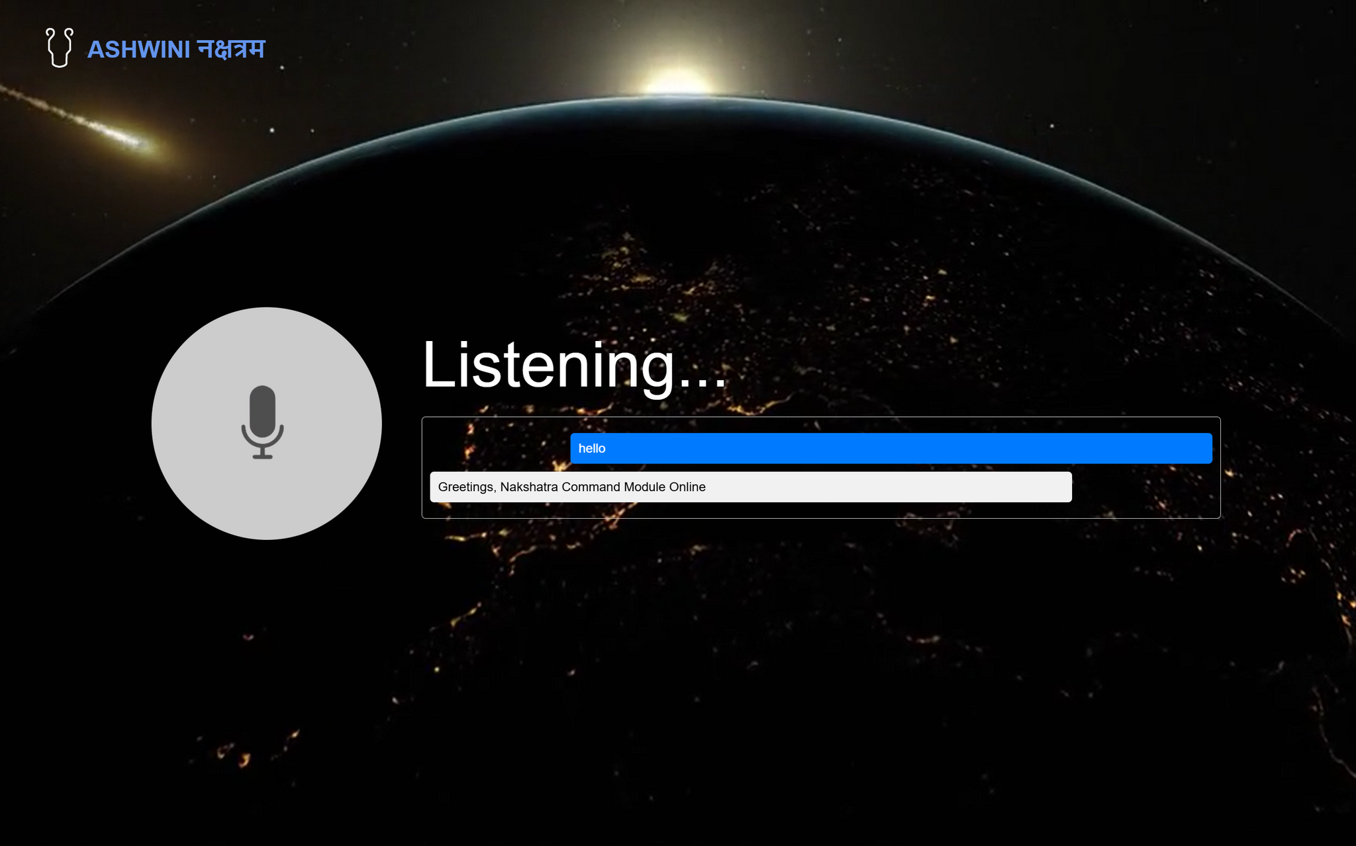
TEAM MEMBERS
Ashwin Rajhans
E23CSEU1220
Raghav Marwaha
E23CSEU1229
Rahul Shadija
E23CSEU1230

Slide 3

OUR VISION
Ashwini Nakshatram is a cutting-edge AI assistant specifically designed to support space missions. Leveraging advanced Natural Language Processing (NLP), it interacts seamlessly with astronauts, offering intuitive and effective communication.
01
The AI ensures astronaut well-being by continuously monitoring both their physical and mental health. It serves as a reliable link between astronauts and ground control, providing updates, alerts, and essential coordination for mission success.
02

Slide 4

TECHNICAL APPROACH
Ashwini's foundation is built using Python, leveraging its robust libraries for Machine Learning and Natural Language Processing (NLP).
Techniques such as regex-based text parsing enable precise understanding and extraction of astronaut commands and inputs for seamless interaction.
The front-end interface is crafted using HTML, CSS, and JavaScript to provide astronauts with an intuitive and responsive user experience.
Dynamic elements ensure real-time updates and smooth communication between Ashwini and its users in challenging space environments.
01
Ashwini integrates NLP modules with mission systems, ensuring efficient data processing and prediction.
The system is optimized for resource-constrained environments, ensuring high performance and reliability during space missions.
02

Slide 5

FEASIBILITY
Leveraging advanced NLP and machine learning for real-time communication and system management is technically feasible with existing technology.
Integrating Ashwini into spacecraft systems is achievable with current hardware and software interfaces.
01
02
Requires investment in development and testing but within the scope of space mission budgets.
03

Slide 6
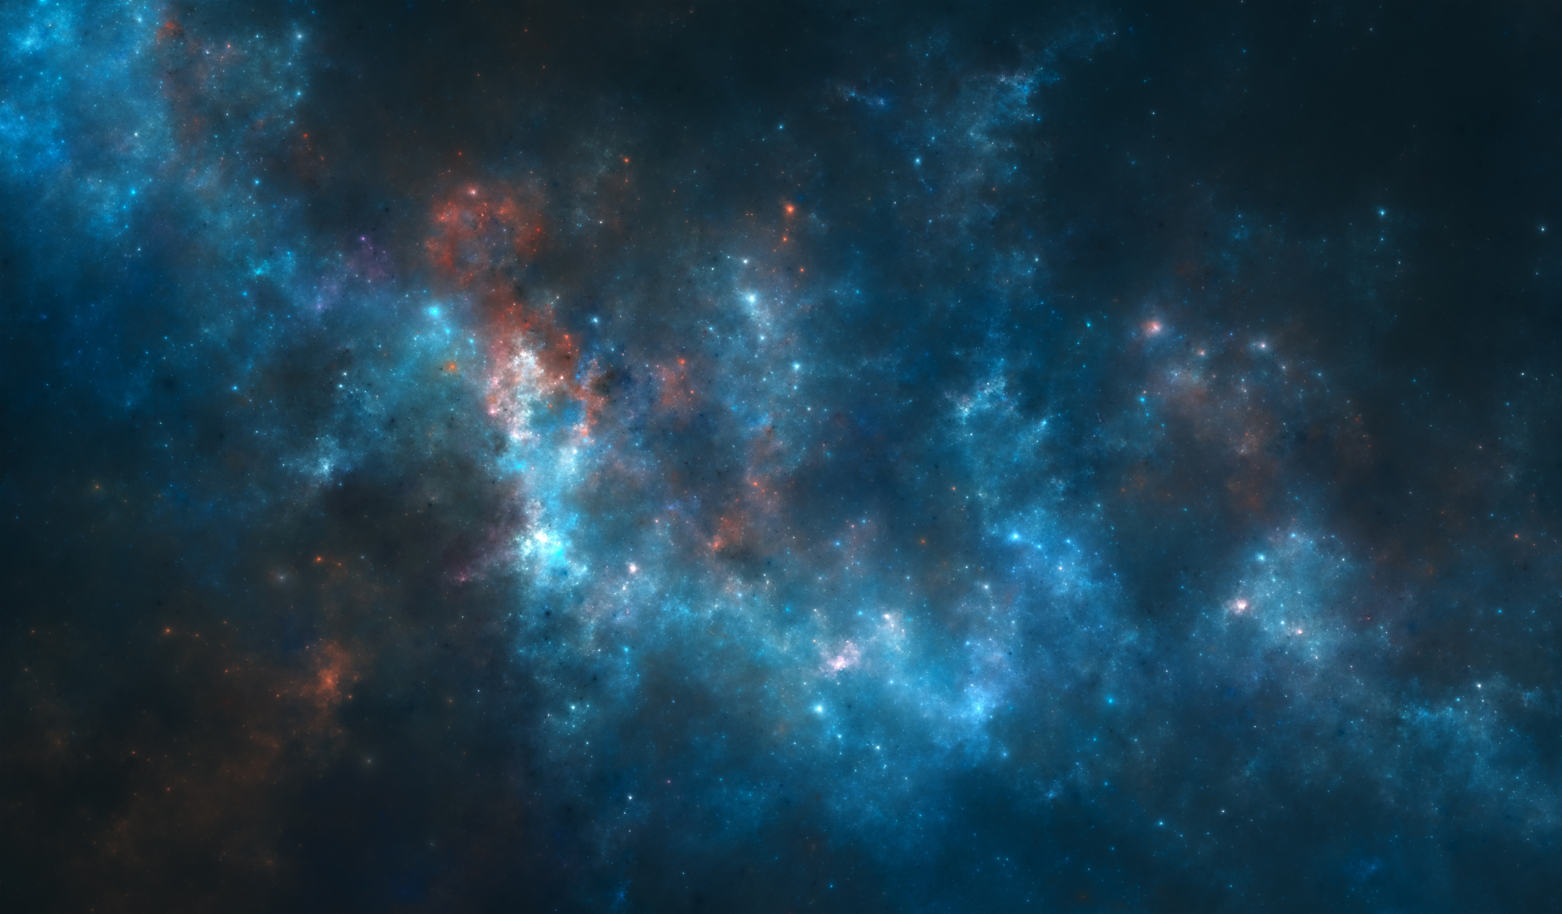
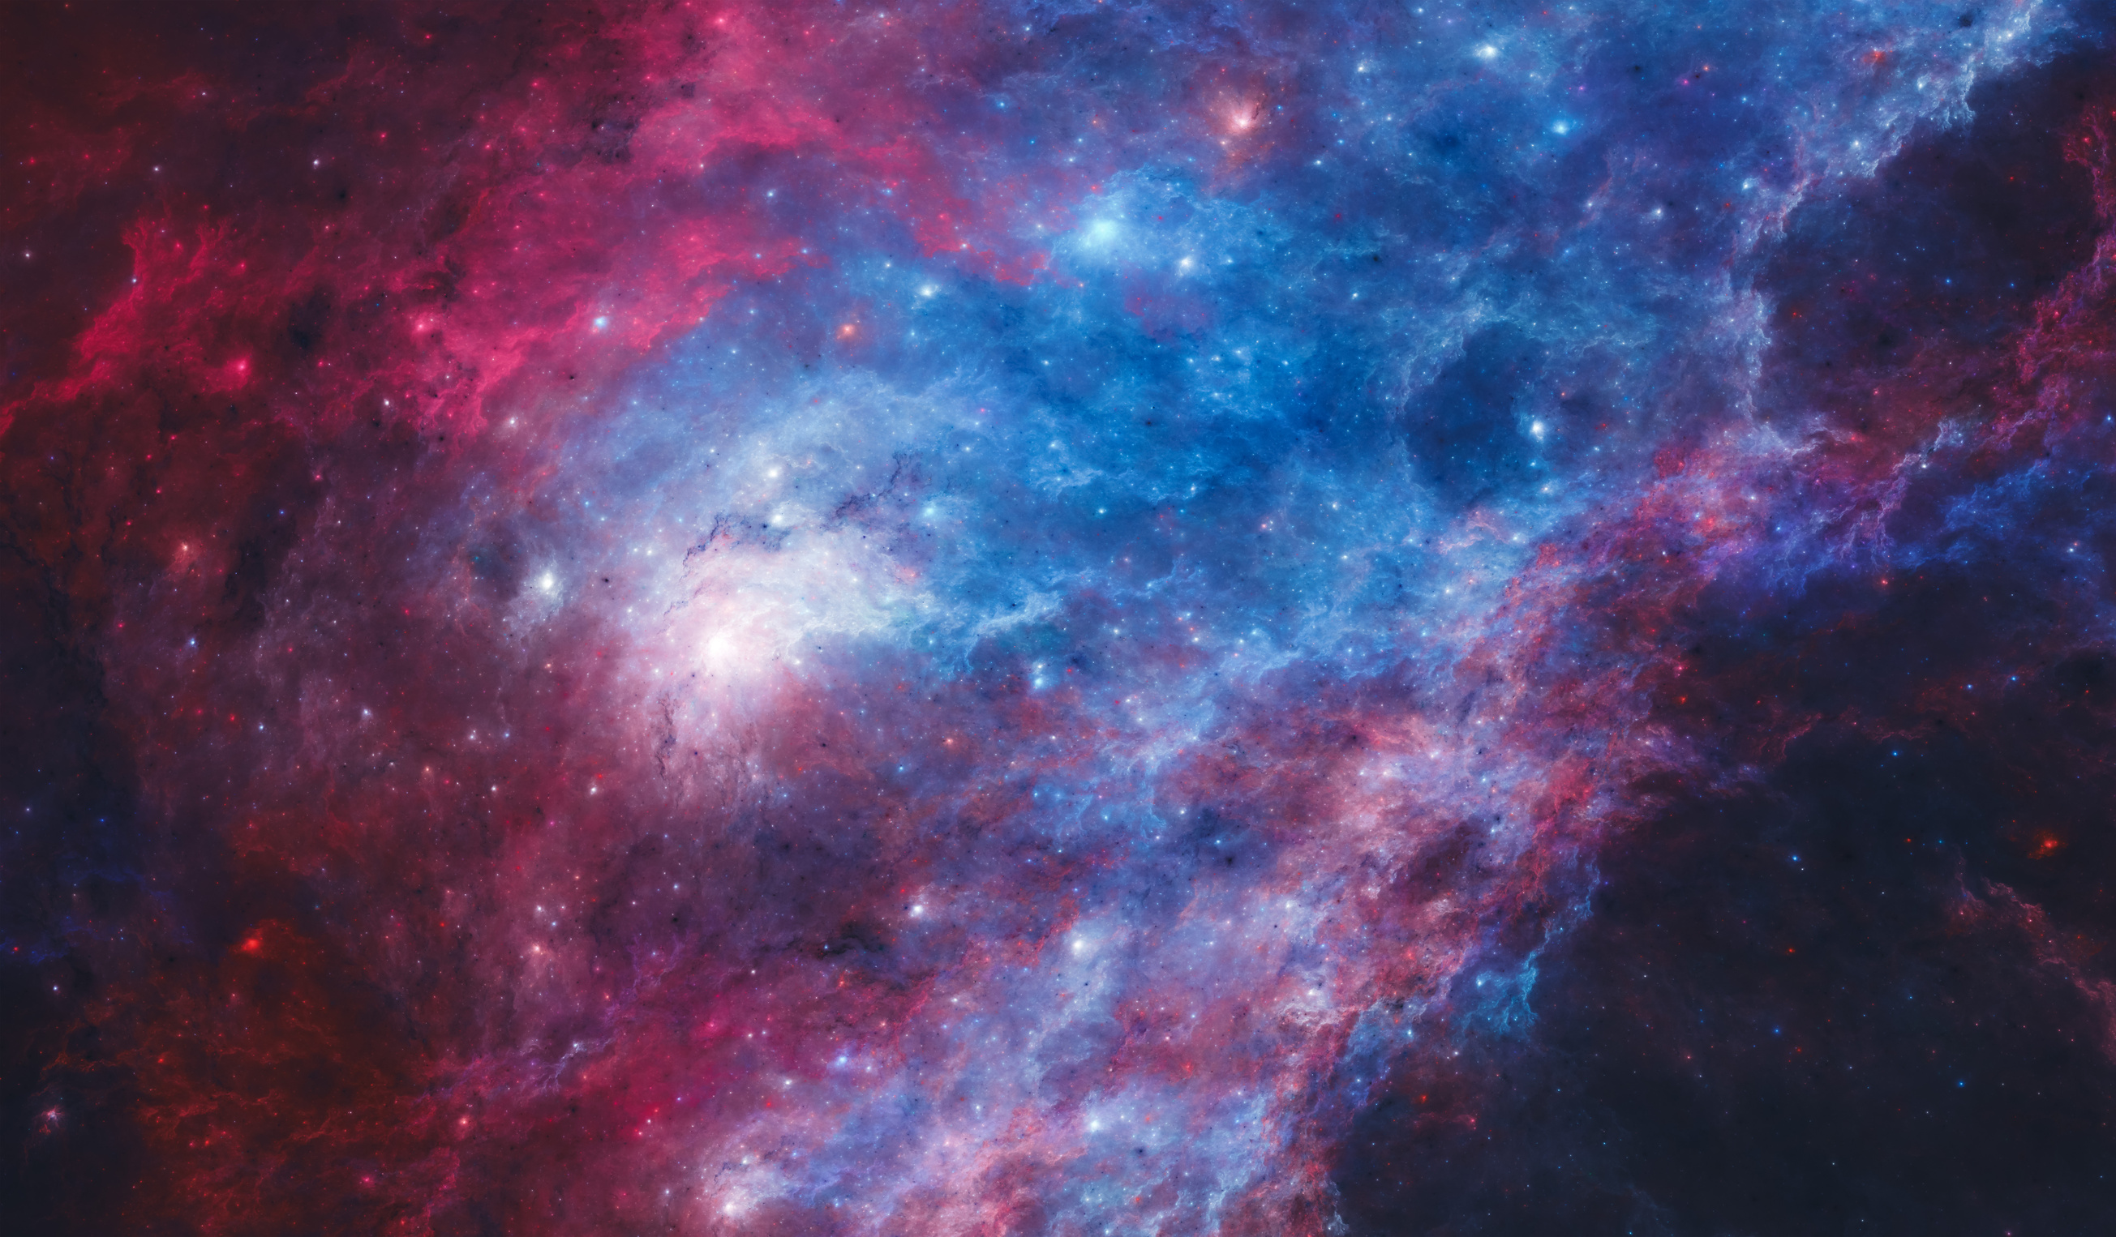

POTENTIAL CHALLENGES
Ensuring secure communication between the AI system and ground control, to overcome this we will implement robust encryption and cybersecurity measures
Maintaining high reliability and robustness in a space environment with limited maintenance opportunities and to ensure this we will conduct extensive testing and simulations to ensure reliability and handle edge cases
Astronauts may resist adopting a new system or find it difficult to interact with, so we can provide thorough training and user support to ensure smooth integration and operation
01
02
03

Slide 7

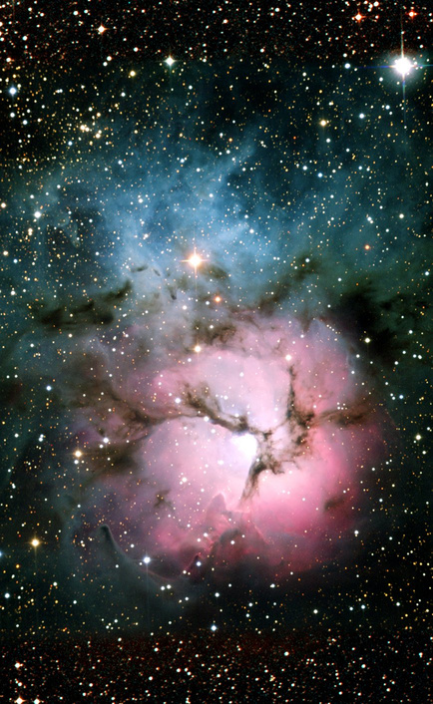
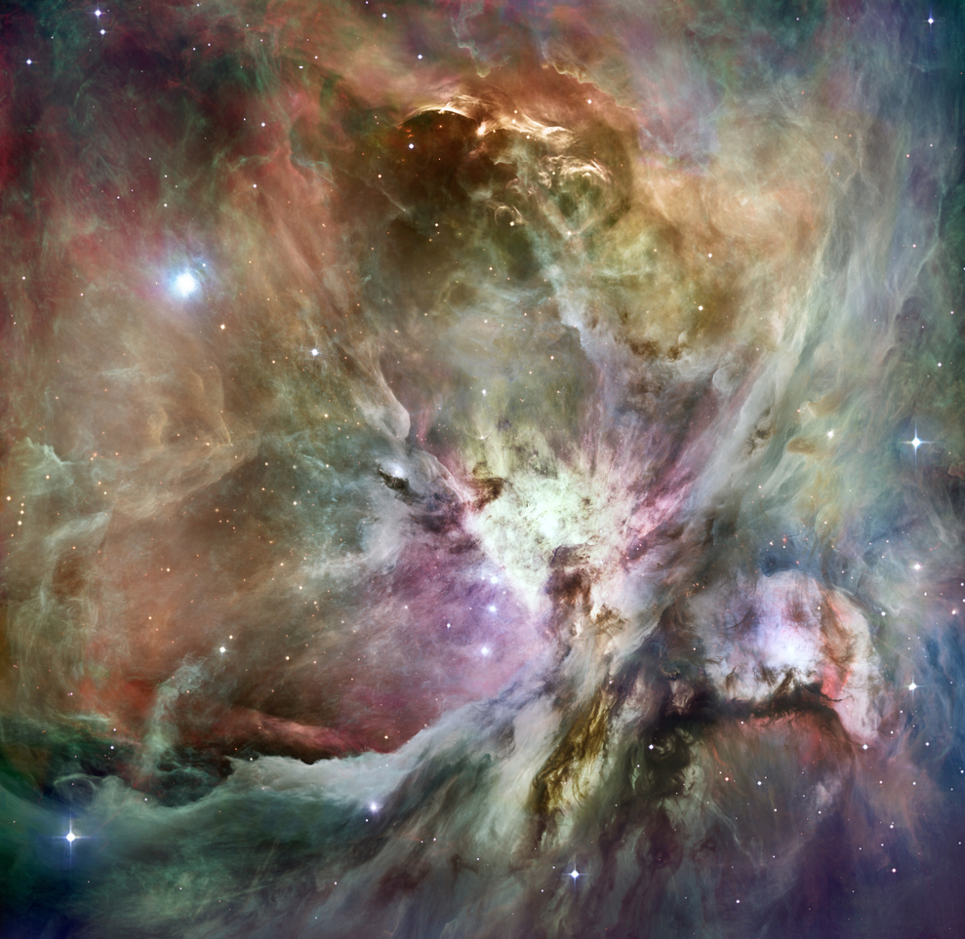

IMPACT AND BENEFITS
Ashwini is an advanced AI system, that significantly enhances astronaut safety and operational efficiency by providing real-time assistance and seamless communication with mission control. This intelligent technology boosts mission success and optimizes resource utilization and life support systems, contributing to more sustainable space missions. By setting a new standard for spacecraft design, Nakshatram influences both the operational and environmental aspects of space exploration, delivering substantial benefits to astronauts and mission control through its innovative approach

Slide 8
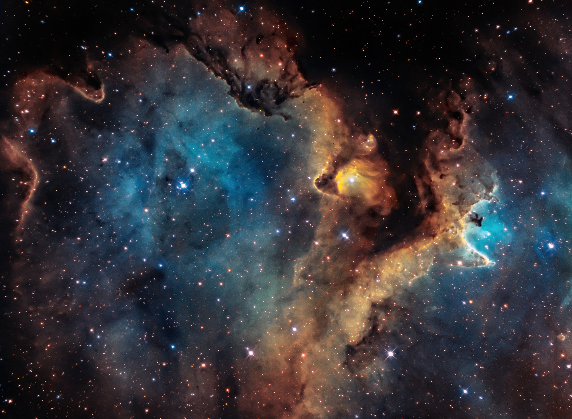
RESEARCH AND REFERENCES
https://www.wikipedia.org
https://www.geeksforgeeks.org
https://www.isro.gov.in
https://www.nasa.gov

Slide 9
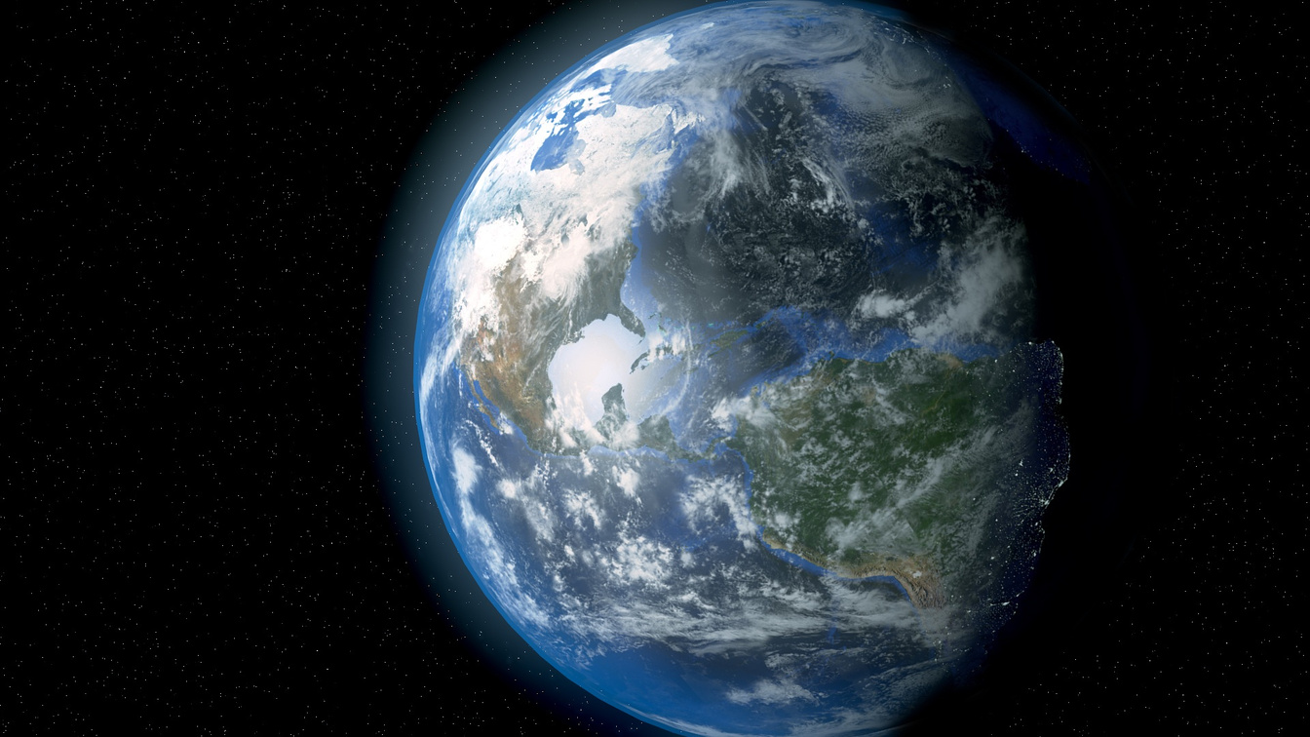

THANK YOU
Ashwini is the first model is currently more like a chatbot however in upcoming versionsit will use the advanced Natural Language Processing and Mathematical Calculations to give much more desired results

